Slide 1

Dynamics CRM Spring Wave New Features

Slide 2
Spring Wave New Features
DYNAMICS CRM 2016

Slide 3

Mitch Milam
Dynamics CRM Architect
Independent consultant and trainer
Ten-Time Dynamics CRM MVP
mitch@xrmcoaches.com
infinite–x.net
@mitchmilam

Slide 4
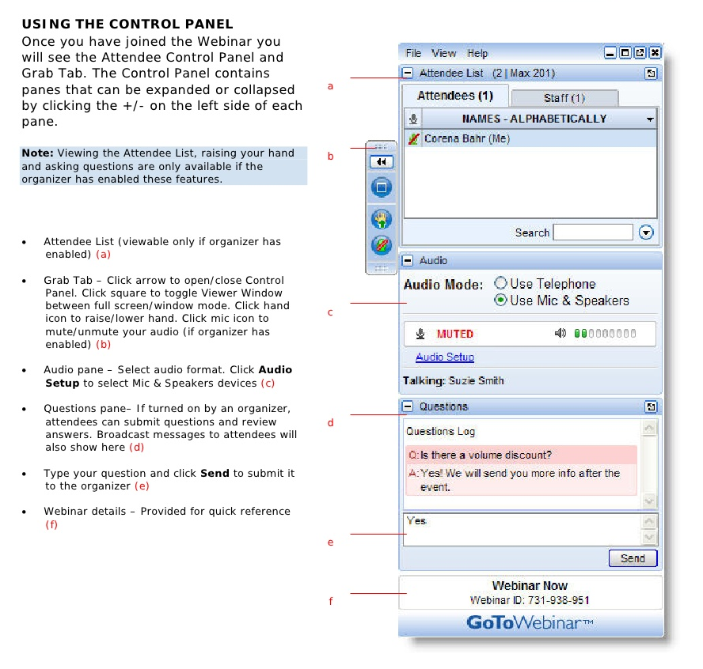
Webinar Housekeeping
Webinar is recorded
Uploaded to YouTube
Follow-up email sent

Slide 5
Future Events
Webinar: Using PowerBI with Dynamics CRM Online
Friday, June 24th, 10:00am Central Time (U.S.) (GMT-5:00)
Workshop: Understanding Dynamics CRM Processes
Starts Tuesday, June 21st.
Morning (10:00am CDT) and Evening (6:00pm) sessions
Meet once per week (2-hours) for 5 weeks
Registration ends tonight at midnight
For more info and to sign up:
http://tinyurl.com/JuneCrmProcesses
** July webinars will be announced soon

Slide 6



2016 Training Roadmap
Webinars
http://www.xrmcoaches.com/webinars
KnowledgeBits
http://www.xrmcoaches.com/knowledgebits
Learning Plans
Availability –Coming soon
More Goodies
Practice tests
On–Demand video training
Instructor–led training
Books

Slide 7
Agenda
What’s new for End-Users
What’s new for Administrators and Customizers
Demonstrations
Q&Q

Slide 8
What is new for End-Users

Slide 9
Productivity

Slide 10
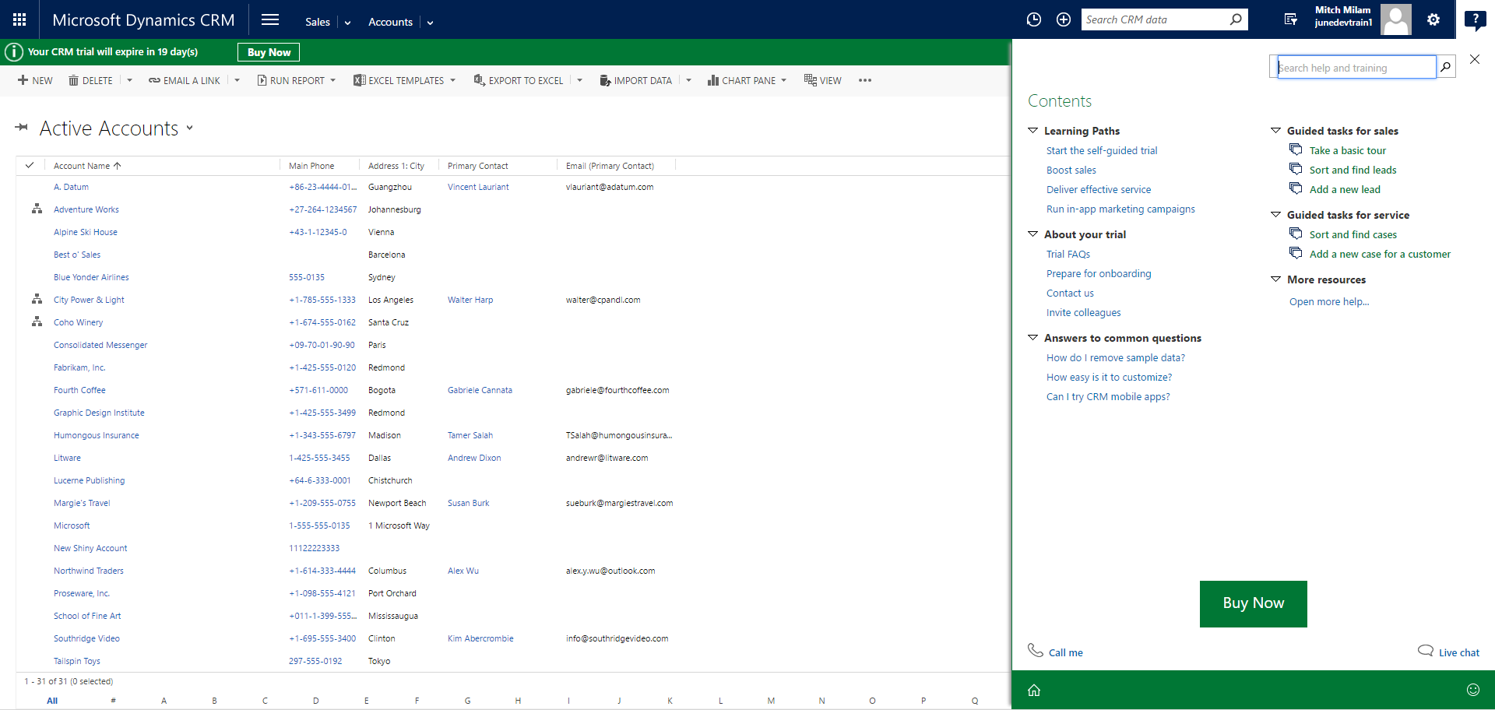
Learning Path

Slide 11
Office 365 Groups
Now, you can set and connect an existing group to different records
Project team members added to a project will be automatically added to that project's group
When a group is deleted so you can connect the record to another group

Slide 12
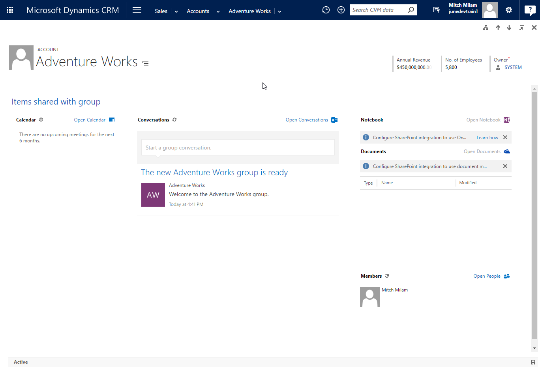
Office 365 Groups

Slide 13
Email Signatures
Define your own signatures
You can also assign a default signature to a queue

Slide 14
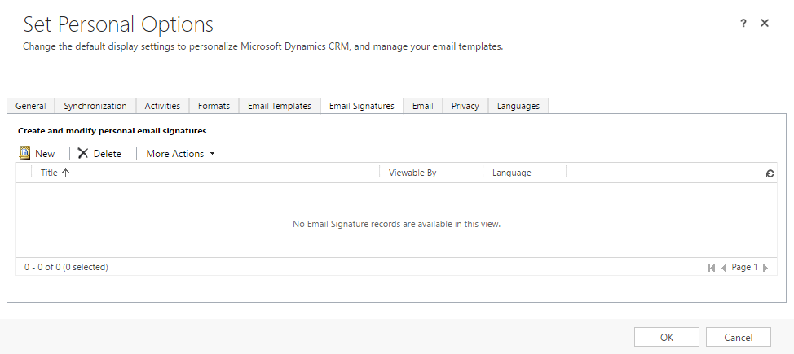
Email Signatures

Slide 15
Multi-Entity Search
Display search results in a single list
Multi-Entity Quick Find Search is now called Categorized Search
** Preview Feature **

Slide 16
Service

Slide 17
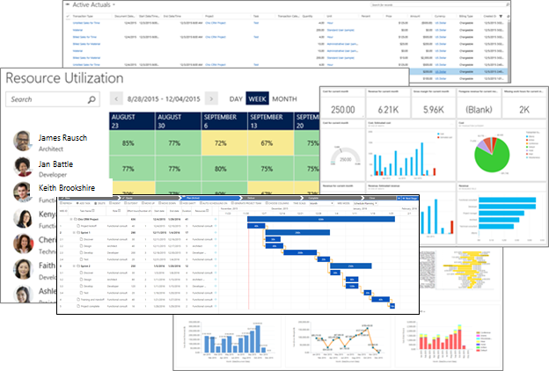
Project Service Automation
Notes:
Name change: From Project Service

Slide 18
Project Service Automation Capabilities
Project-based contracts
Project planning
Resource management
Time and expenses
Project billing

Slide 19
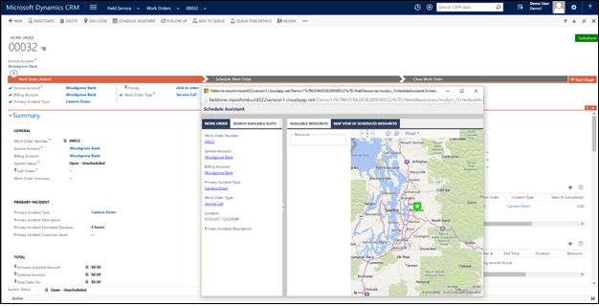
Field Service

Slide 20
Field Service Capabilities
Characteristics and proficiency ratings.
Detached schedule support
Out-of-the-box business processes
Mobile enhancements

Slide 21
Self-Service Portals
Custom portal
Customer Self-Service portal
Employee Self-Service portal
Community portal
Partner portal

Slide 22
SLAs
Create SLAs for any custom entity
And the following system entities:
All activity entities (such as Email, Task, and Appointment) except recurring appointments
Account
Contact
Invoice
Opportunity
Quote
Lead
Order

Slide 23
Interactive Service Hub
Added to main Dynamics CRM Navigation
Apply SLAs for Case and custom entities
Track progress of SLA KPIs with timer control
Remove redundancies between similar cases by merging them into a single case
Access forms and dashboards easily using keyboard navigation.

Slide 24
Mobile

Slide 25
Mobile Enhancements
Improved Offline experience
View, update, delete
Service reps can now:
Search for, view, create, and edit knowledge articles
Sales professionals can now:
Manage quotes, orders, and invoices
Company News Component added

Slide 26
Analytics

Slide 27
Power BI
New Service Content Pack
Improved Sales Manager Content Pack
Embed Power BI tiles directly into CRM dashboards

Slide 28
What is new for Administrators and Customizers

Slide 29
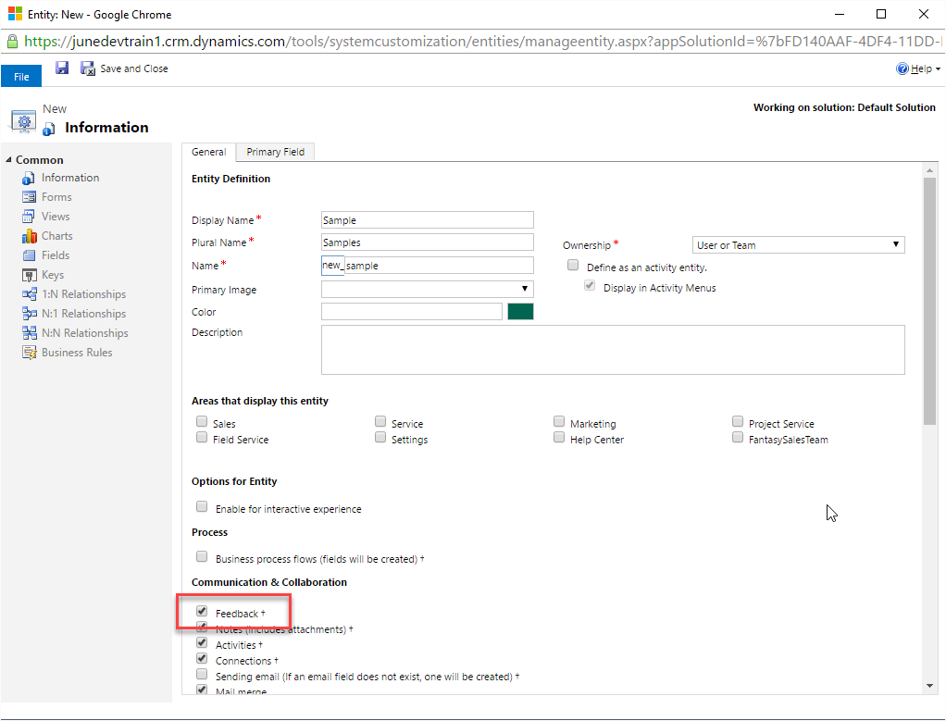
Feedback and Ratings

Slide 30
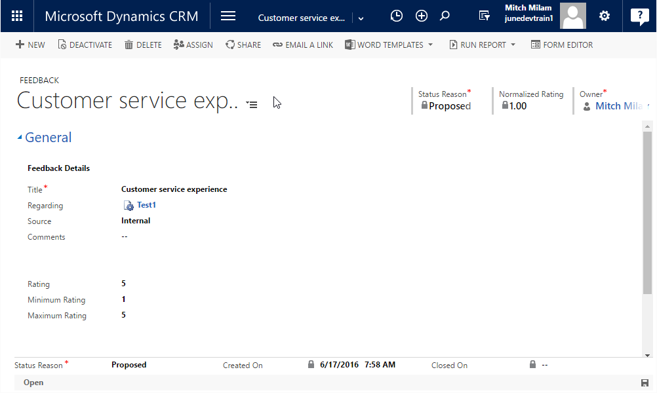
Feedback and Ratings

Slide 31
Product Recommendations
Uses Azure Machine Learning
You build a machine-learning-based recommendation model
automatic cross-sell product recommendations based on historical transaction data
** Preview Feature **

Slide 32
Suggested KnowledgeBase Articles
Uses Azure Machine Learning Text Analyitics
Automatically provide your more relevant solutions from the knowledge base
** Preview Feature **

Slide 33
Interactive Service Hub
Add iFrames and web resources to the interactive experience forms to support extensibility scenarios
Configure the lookup field properties to show filtered records in the interactive experience forms
Configure language filters in the Knowledge Article Search pane so Customer Service Reps can filter knowledge articles based on languages
Add the SLA timer to the Main interactive experience form

Slide 34
Unified Service Desk
Interactive service hub integration
Now part of Windows Update
Demo packages include new samples
Telemetry (send usage data to Microsoft)

Slide 35
Mobile Management
Managed by Intune Mobile Application Management (MAM) without enrolling the device

Slide 36
Mobile Device Conditional Access
Use Azure with CRM Online to set up conditional access from mobile devices
Configure conditions for CRM access at the Azure Active Directory group level
The device they use must be:
Enrolled with Intune or a domain-joined PC
Registered in Azure Active Directory (automatic when device is enrolled with Intune)
Compliant with any System Center Configuration Manager compliance policies deployed to that device
If a conditional access condition is not met, the user receives one of the following messages:
If the device isn’t enrolled with Intune, or isn’t registered in Azure Active Directory, a message provides instructions about how to install and enroll
Non-compliant devices are redirected to the Intune web portal

Slide 37
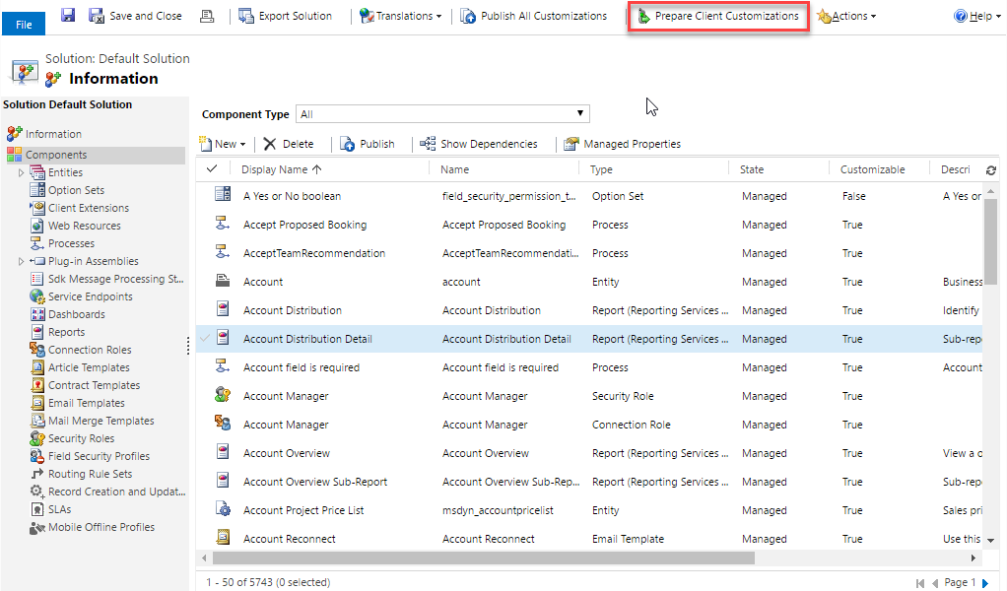
Faster Mobile App Preparation

Slide 38
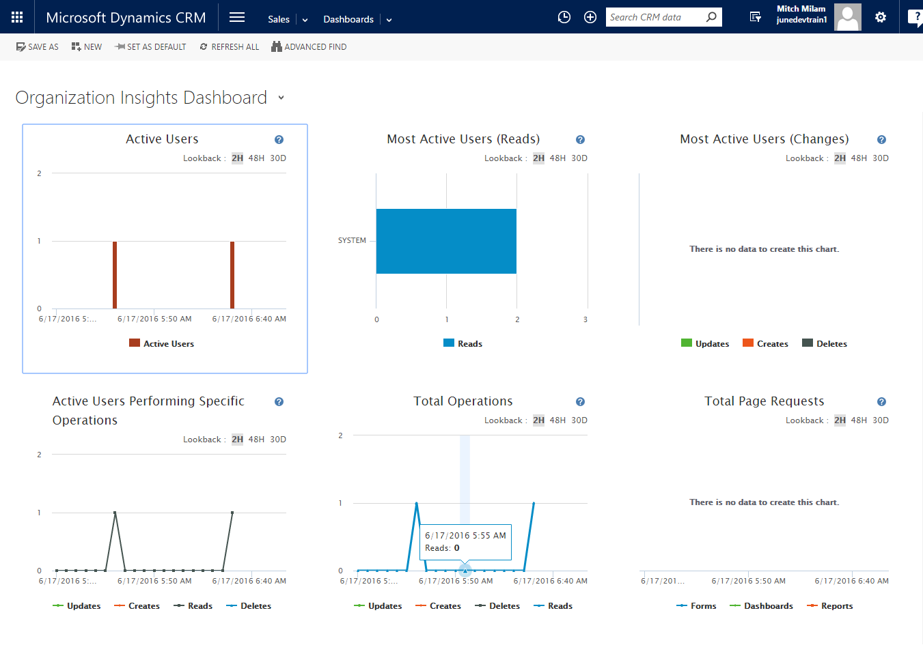
Organization Insights Dashboard
** Preview Feature **

Slide 39
Performance: Optimize query load time
Dynamics CRM Online-only
Identify long-running queries
Add query optimizations
Remove query optimizations

Slide 40
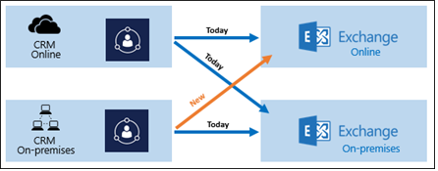
Hybrid server-side sync (CRM on-premises to Exchange Online)

Slide 41
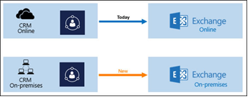
CRM App for Outlook available for CRM on-premises

Slide 42
CRM App for Outlook available for CRM on-premises
Client | Read email | Compose email
Outlook on the web (OWA) on all major desktop browsers | Yes | Yes
Outlook 2013 | Yes | No
Outlook 2016 | Yes | Yes
Outlook for Mac | Yes | No

Slide 43
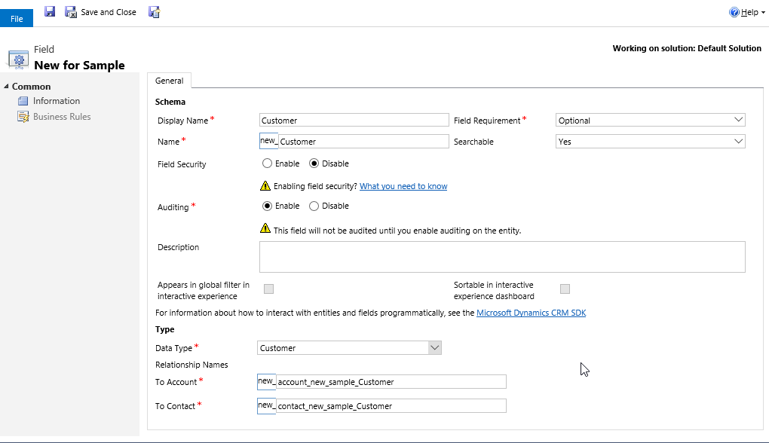
Customer field for any entity
Allows you to add a single lookup for:
Account
Contact

Slide 44
Package Deployer
Package Deployer tool now runs from a command prompt

Slide 45
Demonstrations

Slide 46
Questions?

Slide 47
Thank You

